Slide 1
INVESTMENT CASE STUDY SUBMISSION
Submitted by :-
Vibhor Malik

Slide 2
Case Study : Spark Funds Investment
Spark Funds wants to make investments in a few companies. With the help of global trends in investment they want to take the investment decision effectively. The overall aim of analysis is where to invest.
Business Constraints :
Company wants to invest between 5 to 15 million USD per round of investment.
Company wants to invest in English-speaking countries.
Objective : To identify the best countries, sectors and suitable investment is required.
Goals :
Investment type analysis
Country analysis
Sector Analysis

Slide 3
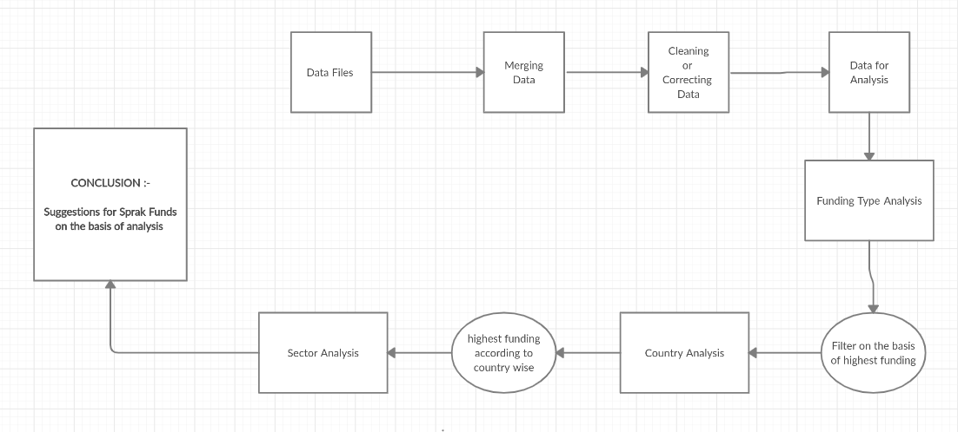
Problem solving methodology

Slide 4
Investment type analysis
According to analysis Venture is the most common type of Funding Round with 50228 followed by seed with 23602 and debt_financing with 6682.
Private Equity has very high value of average raised amount, but it is not match with the current investment bar of our company.
The most representative value of the investment amount for each funding types is :
Based on above data analysis, funding_round_type and raised_amount_usd equals to venture only satisfies criteria for Spark Funds to invest between 5 to 15 million USD per investment round.
Investment Type | Average Investment amount
angel | 958694
private_equity | 73308593
seed | 719779
venture | 11748949

Slide 5
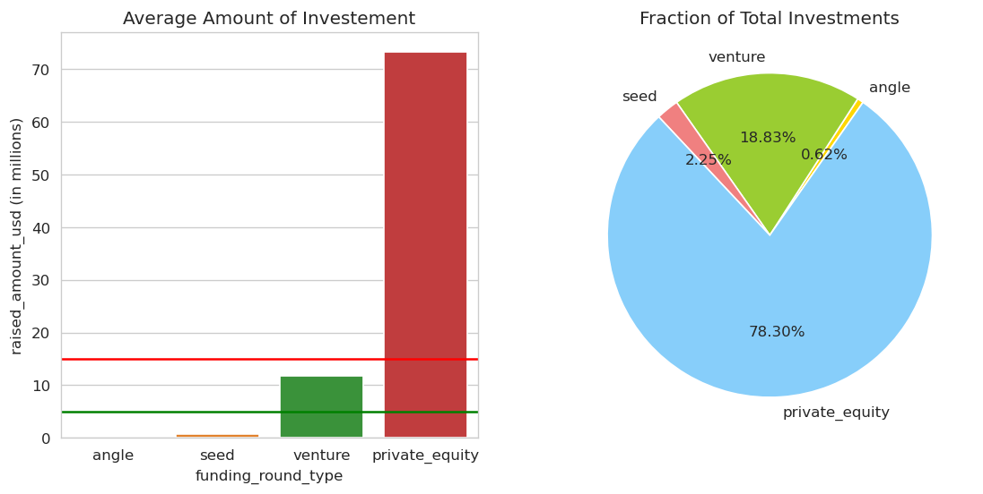
Investment type analysis (Result)

Slide 6
Country analysis
There are 97+ countries for the investing into venture.
Based on analysis the top 9 countries fit for investment is shown below :-
But top 3 English speaking countries from above are USA, United Kingdom(GBR) and India(IND) so Company needs to invest in these country
Country Name | Investment Amount
USA | 422510842796
CHN | 39835418773
GBR | 20245627416
IND | 14391858718
CAN | 9583332317
FRA | 7259536732
ISR | 6907514579
DEU | 6346959822
JPN | 3363676611

Slide 7
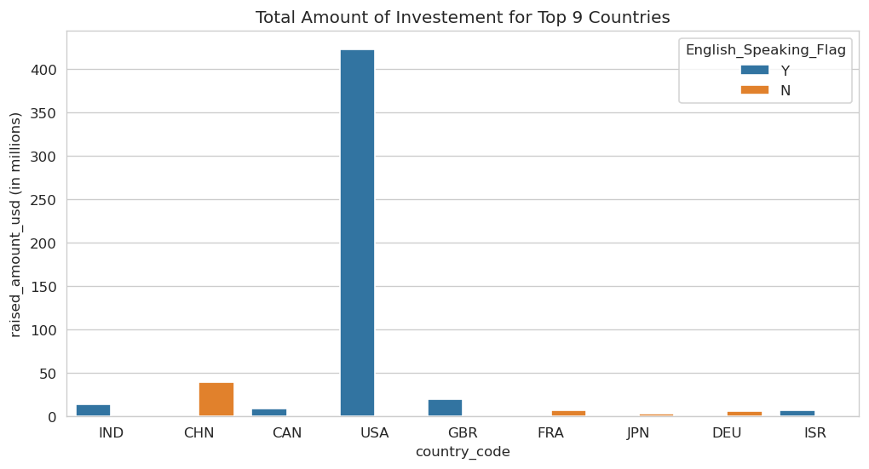
Country analysis (Results)

Slide 8
Sector Analysis
There are 8 main Sectors for investments. These are `Others`,`Cleantech / Semiconductors`,` Social, Finance, Analytics, Advertising`,`News, Search and Messaging`,Health`,`Manufacturing`,`Entertainment`,`Automotive & Sports`.
Based on 3 main sectors of 3 english speaking country is as follows :-
Country | Main Sector Name | Number of Investment
USA | Others | 2950
 | Social, Finance, Analytics, Advertising | 2714
 | Cleantech / Semiconductors | 2350
GBR | Others | 147
 | Social, Finance, Analytics, Advertising | 133
 | Cleantech / Semiconductors | 130
IND | Others | 110
 | Social, Finance, Analytics, Advertising | 60
 | News, Search and Messaging | 52

Slide 9
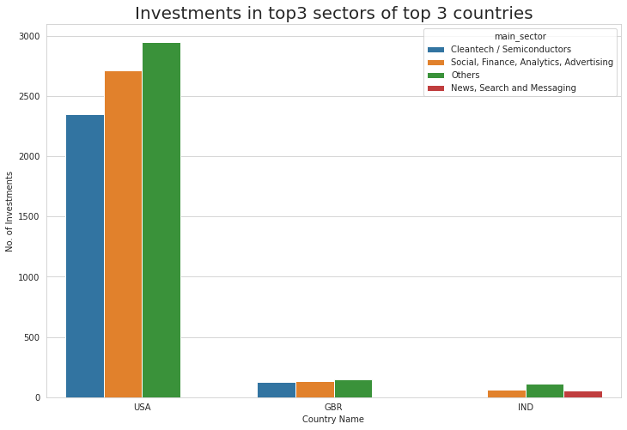
Sector Analysis (Result)

Slide 10
Conclusions
From all Data Analysis there are following strategy Spark funds considering for Investment
Spark Fund should consider investing in funding type venture in Others main sector of USA as that is the choice of many investors for investment.
If Spark Funds wants to invest in different countries other than USA, United Kingdom and India in funding type venture and main sector is Others
If Spark Funds wants to invest in different sectors to reduce the risk along with above top 3 countries with top 3 sectors as mention in previous slide.

